Slide 1

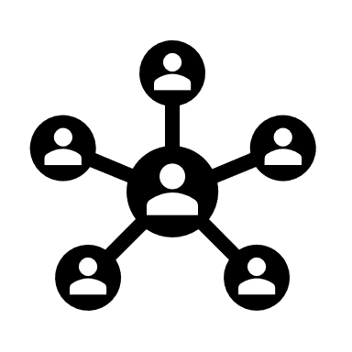
Customer behavior Analysis
Elnaz Allahbakhshi

Slide 2




Agenda
Introduction
Business Problem and Questions
Data Features
Analysis
Methods used
Clusters
Recommendations and Strategies

Slide 3




Introduction
Customer Personality Analysis is a detailed analysis of a company’s ideal customers.
It helps a business to better understand its customers and makes it easier for them to modify products according to the specific needs, behaviors and concerns of different types of customers.
Customer personality analysis helps a business to modify its product based on its target customers from different types of customer segments. For example, instead of spending money to market a new product to every customer in the company’s database, a company can analyze which customer segment is most likely to buy the product and then market the product only on that segment.

Slide 4


Business Problem & Questions

Slide 5
How to make Marketing strategies !
What are the characteristics of customer statistics?
What are the customer's shopping habits?
Are there some products that need more marketing?
How can marketing be made effective?

Slide 6
Data Features:
People
Products
Promotions
Places
Notes:
The dataset has 29 features and 2240 entries

Slide 7

Analysis

Slide 8
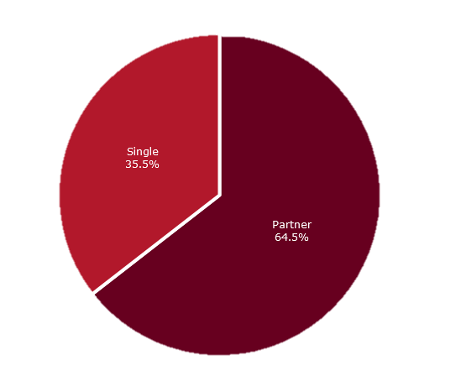
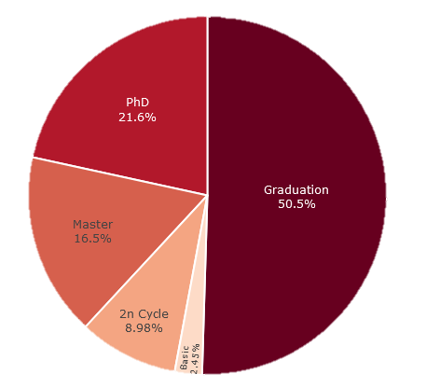
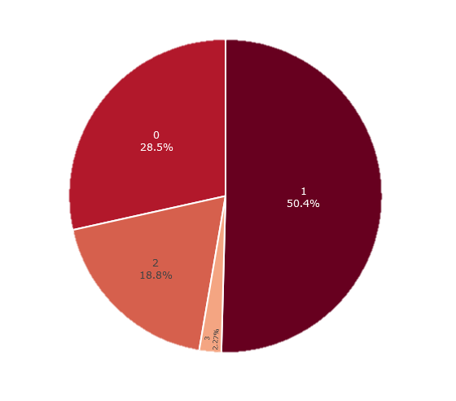
Demographic of Customers :
Marital Statues
Education Level
Number of Children
Notes:
2/3 of customers live with a partner while about 1/3 are single
Half of the customers are University graduates
There are more customers who have PhD degrees than customers who have Masters degrees
About 50% of customers only have one child
28% of customers do not have children at home while 19% of them have 2 children

Slide 9
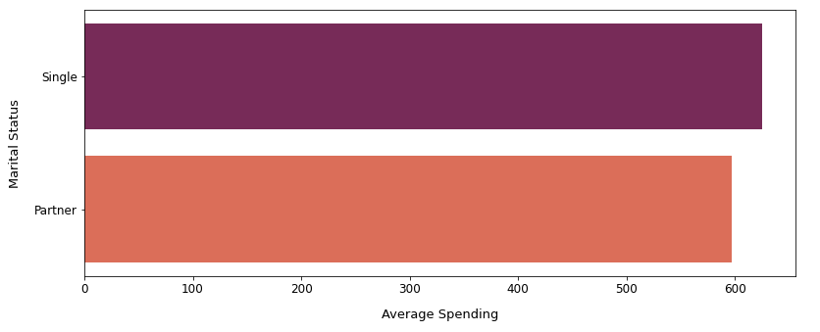
Demographic of the customers VS Total Spendings :
Single customers are spending 10% more than customers with partners
Notes:
Despite being a minority, singles on average spend more money than customers who have partners

Slide 10
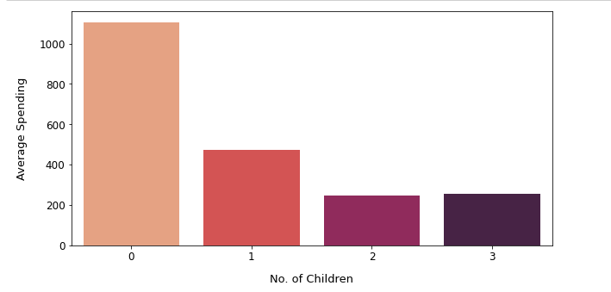
Customers household VS spending :
Customers who has no child are significantly spending more money than customers who has kids,
Relatively its seen that the greater number of kids the less is avg spending.
Notes:
Customers who do not have children at home spend more than customers who have 1 child. Customers with 1 child spend higher than customers with 2 and 3 children.

Slide 11
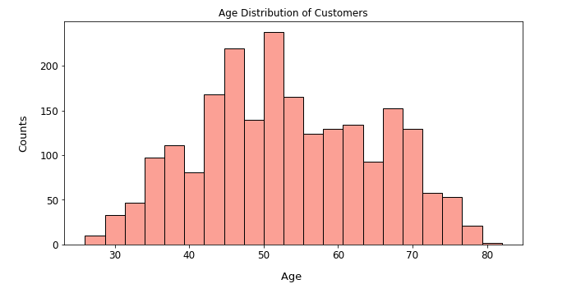
Age Distribution of Customers
Notes:
The age of the customers is almost normally distributed, with most of the customers between the ages of 40 and 60.

Slide 12
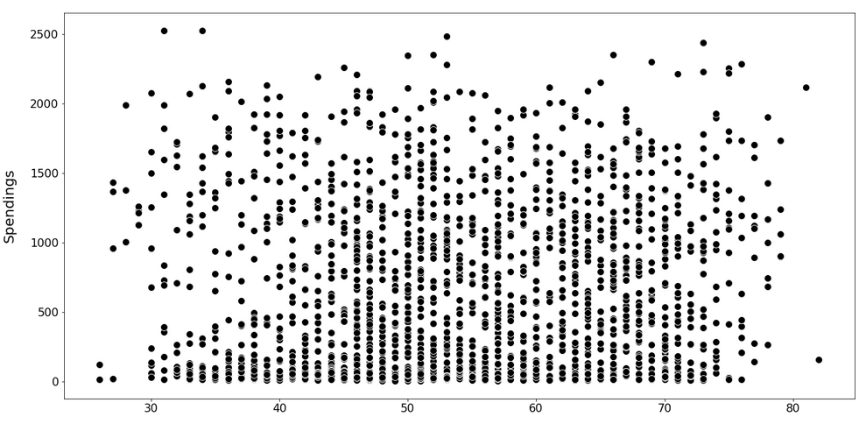
Correlation : Age vs Spendings
Notes:
There seems to be no clear relationship between the age of the customers and their shopping habits.

Slide 13
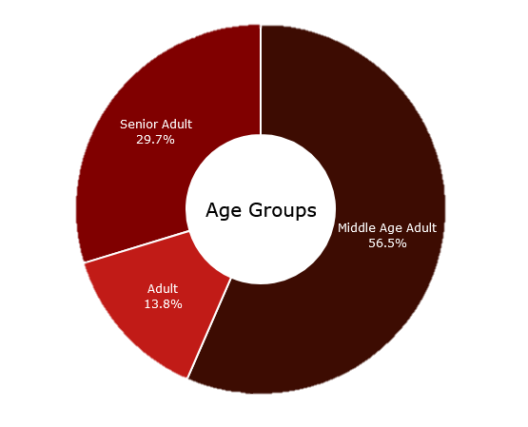
Customers Segmentation: Age Group
Customers above 60 years old segmented as “Senior Adults “
Customers who were 40 or above was grouped as “Middle Adults”
Customers below that was defined as “Adults”
Notes:
More than 50% of customers are Middle-Aged Adults between 40 and 60
The 2nd well-known age category is Adults, aged between 20 and 40

Slide 14
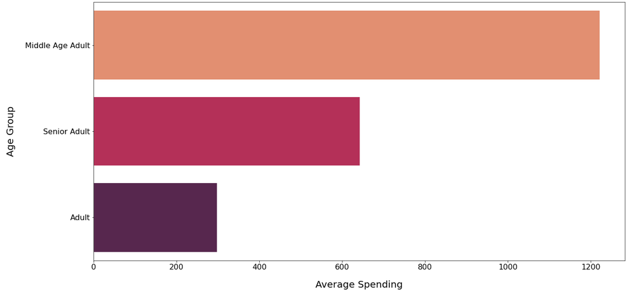
Age group VS Spending
Notes:
Middle-aged adults spend more than any other age group.

Slide 15
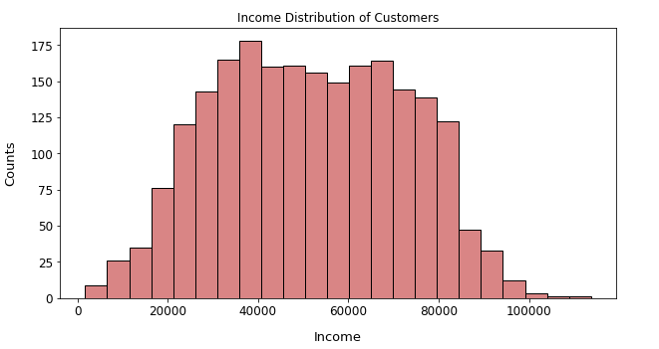
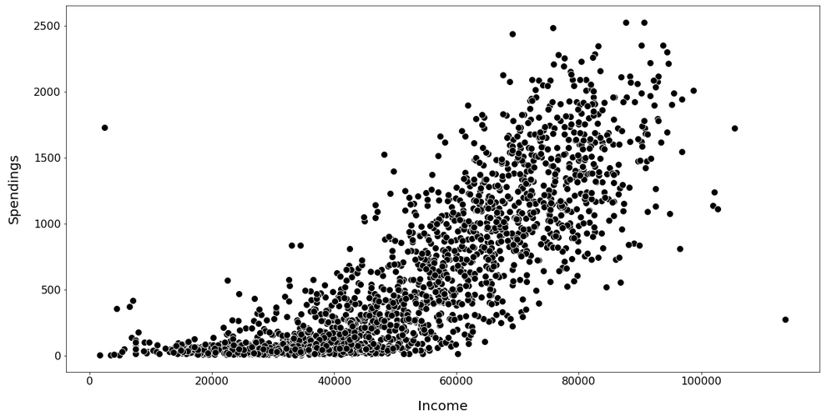
Income of customers and Spendings
Notes:
There is a linear correlation. Customers with higher salaries spend more

Slide 16
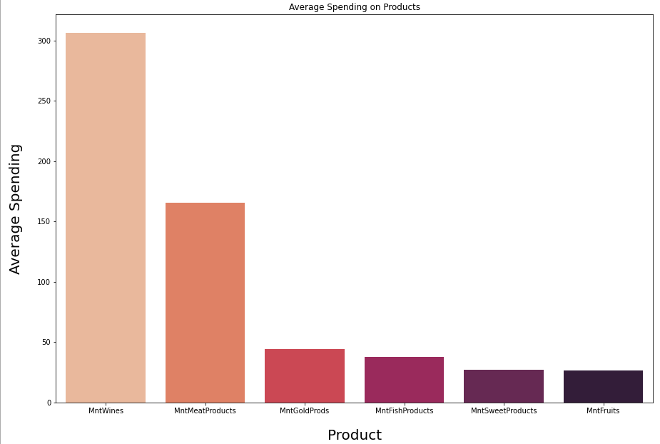
Average Spendings on Products
Notes:
Wine and Meat Products are the most famous products among customers
sweets and Fruits are not often bought

Slide 17
Methods used:
In this work I will do a cluster analysis for the problem of customer segmentation in the store
Cluster analysis refers to an unsupervised machine learning task (when there are no labels in the dataset)
Cluster analysis is used where we need to break the general population into different groups, where the objects in each group are most like each other. In our example, we break the general population into separate groups in order to analyze these groups separately and, for example, make recommendations for purchases for them
As part of this work, all stages of machine learning for cluster analysis will be considered
The goal of this work was to obtain the necessary recommendations for business based on the results of cluster analysis

Slide 18
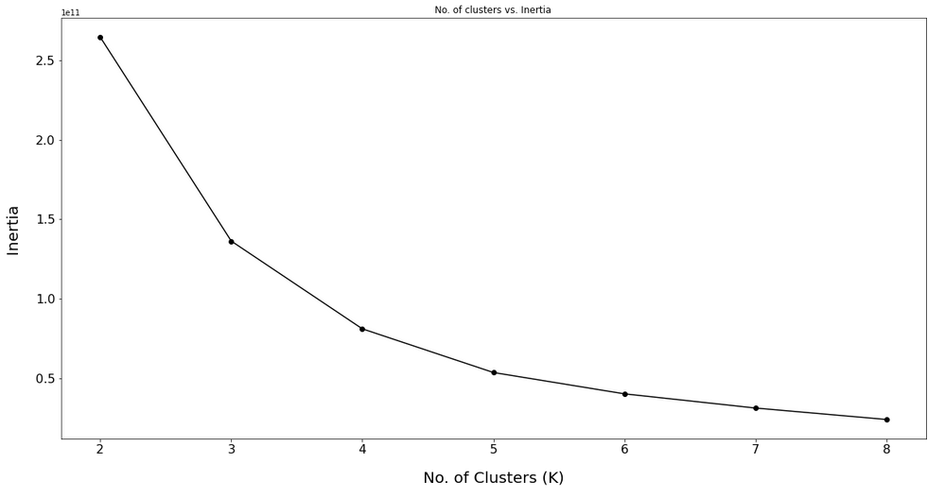
Optimum Clusters Using Elbow Method
Notes:
Based on the plot above we will group customers into 4 clusters, because the inertia value does not decrease much after 4 clusters.

Slide 19
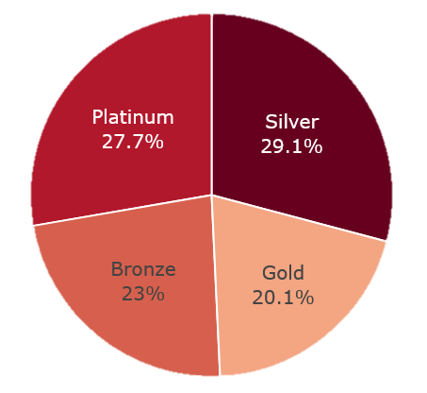
Customer Distribution based on clustering
Notes:
Most customers are in the Silver and Gold categories, around 29% and 28% respectively
Platinum is the 3rd well-known customer category with 23% while only 20% occupies the bronze category

Slide 20
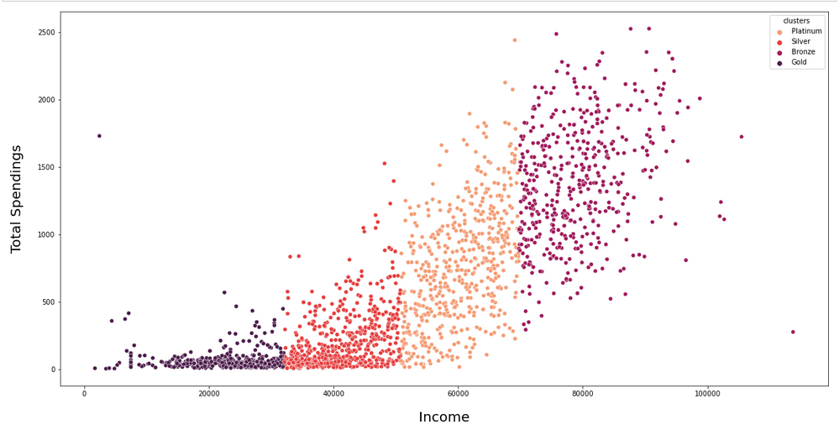
Correlation : Income vs. Spendings
Notes:
4 clusters can be easily identified from the plot above
Those who earn more also spend more

Slide 21
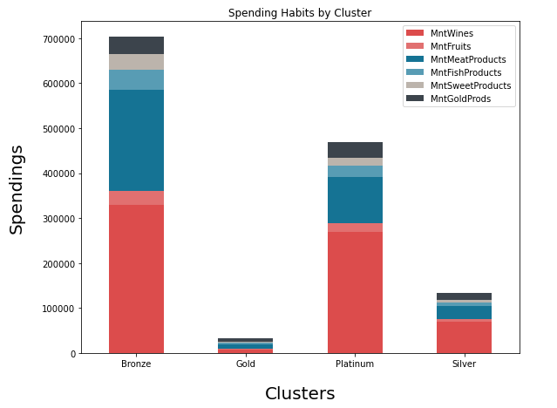
Spending Habits by Clusters
Notes:
Customers from all segments have spent most of their money on Wine and Meat products

Slide 22
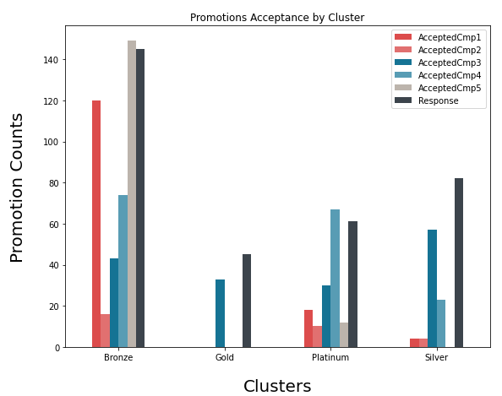
Promotions Acceptance by Clusters
Notes:
Platinum customers receive most of the offers from the company Campaigns 1, 5 and the last seem to be the most successful The bronze category shows the lowest interest in the company's promotional campaign

Slide 23
Best Performing Clusters
Silver
Bronze
1. Well Educated
2. Adults & Middle Aged
3. No Kids
4. High Income
5. High Expenditure
6. More shopping
7. Positive reply to campaigns
8. Not into deals and discount
1. Most number of customers
2. Graduates & Post Graduates
3. Middle Aged & Adults
4. Has 1 kid or Teen
5. Second Highest Income
6. Above Average expenditure
7. High number of purchases
8. Likes to claim deals

Slide 24
Worst Performing Clusters
Platinum
Gold
1. Least number of customers
2. Graduates & post graduates
3. More middle aged than adults
4. Has 2 kids or teens
5. Average Income
6. Low expenditure
7. Less shopping
8. Not attracted towards campaigns
9. Into deals & discounts
1. Graduates and undergraduates
2. Large number of adults
3. Low Income
4. Has 0 or 1 children
5. Low expenditure
6. Less shopping
7. Have accepted few campaigns and deals

Slide 25

Answer to the Questions

Slide 26
What are the characteristics of customer statistics?
The company's customers are mostly married. There are more middle-aged adults, aged between 40 and 60 and most of them would like to have one child. Most of the customers hold a college degree and their income is mostly between 25,000 and 85,000

Slide 27
What are the customer's shopping habits?
Customers have spent more on wine and meat products. Those who do not have children have spent more than those who have children. Single spend more than one with a partner. Middle-aged adults have spent more than any other age group. In-store shopping is the preferred channel for buying among customers. Web and Catalog Purchasing also has potential.

Slide 28
Are there some products that need more marketing?
Sweet and Fruit products require effective marketing. Companies need to do promotions for these products in order to increase revenue from these products. A basket of products with the fewest sales combined with the products that sell the most can be effective.

Slide 29
How can marketing be made effective?
As a marketing recommendation, give coupons to existing and high-spending customers. Marketing of low-cost products and products offered to low-income and low-spending customers. Web buying has some potential. To unlock this, give a special discount to customers who register on the company's website

Slide 30



Thank You

